Slide 1
Developing and Testing a Web-Based Provider Training for Cognitive Behavioral Therapy of Insomnia.
Military Medicine
Daniel Carlsson

Slide 2
Purpose of the article
to make cognitive behavioral therapy for insomnia (CBT-I) more accessible and effective for health providers especially for the military.
Improve the long-term benefits compared to medical supplements.
Improve day-to-day work for patients in a more cost-effective way.

Slide 3
Methods used
The course was designed by specialists in user-centered web design and the content was developed by experts in CBT-I and military behavioral health.
The course was refined through alpha and beta testing and feedback from CBT-I behavioral health providers.
A pilot study was also conducted to compare the effectiveness of CBTIweb.org to an in-person workshop.
Pilot-study
Licensed CBT-I health providers
Alfa-testing
Only invited
Beta-testing
Nationwide

Slide 4
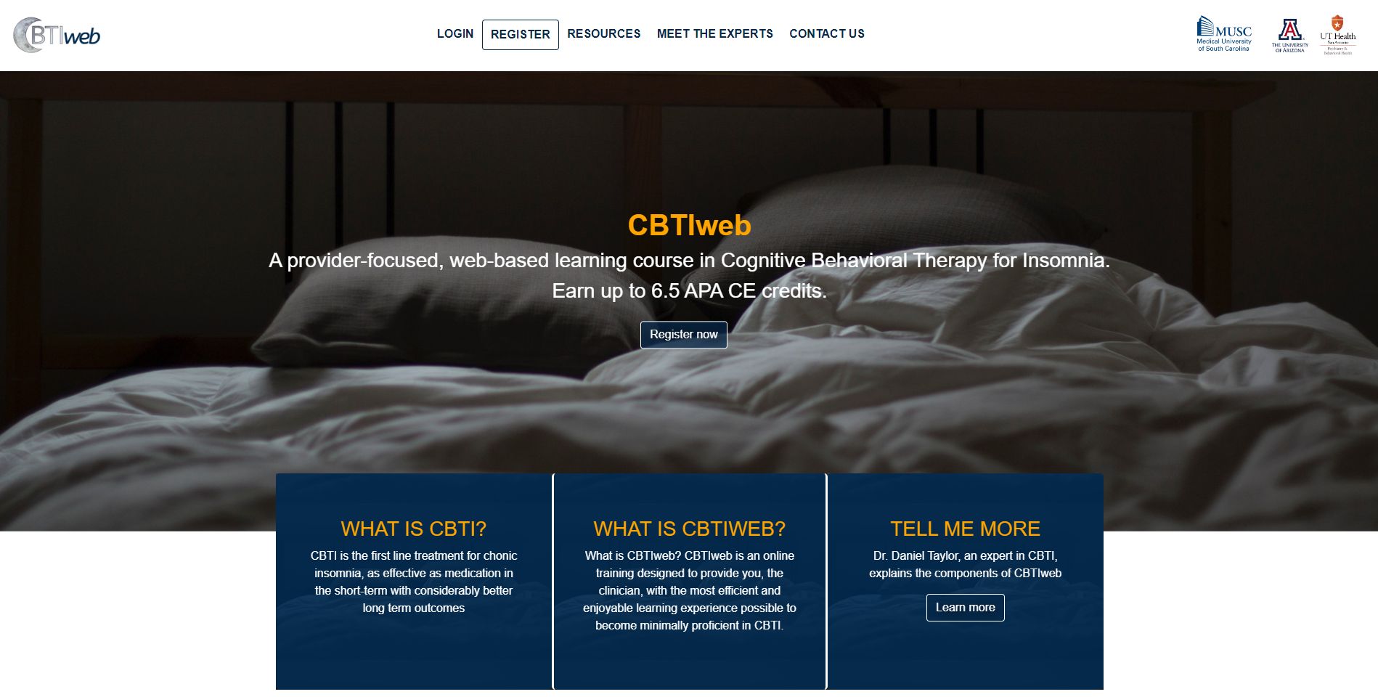
CBTIweb.org

Slide 5
Future work
Translating this training to other languages
Extending this web-based platform to the treatment of other sleep disorders (e.g., nightmares) and populations (e.g., pediatric populations with insomnia).

Slide 6
Validity - reviewed and approved
The Medical University of South Carolina Institutional Review Board.
The U.S. Army Medical Research and Development Command Office of Research Protections.

Slide 7

Thank You For Listening

